Slide 1
Lab 2 Sensor and Camera Programming Lecture: Feb 2 / Feb 4 Demo: Feb 9 / Feb 11 Hard Deadline: Feb 16 / Feb 18
Notes:
Review today, not so fast in future

Slide 2
Today’s Schedule
Lab 2 lecture (in zoom main session)
Lab 2 implementation / discussion (in zoom main session)
Lab 1 demo / Lab 2 question with TA (in zoom breakout room)

Slide 3
Lab 2a
Notes:
Review today, not so fast in future

Slide 4
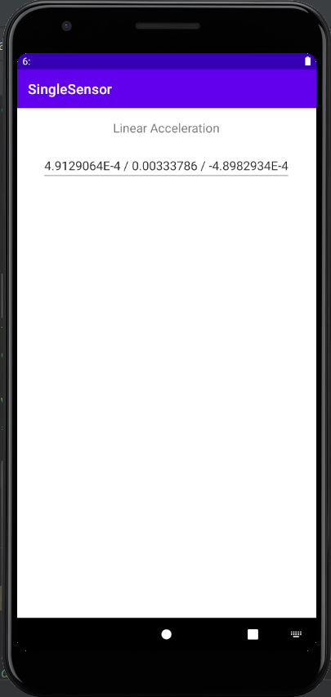
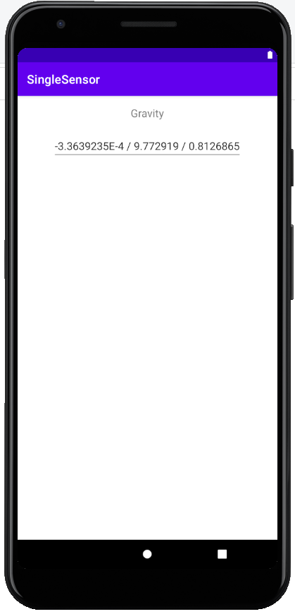
Requirement
Lab 2a: sensor
I will show you:
Display accelerometer sensor
You will do:
Display gravity sensor
(If have more time)
Display both on one screen
Demo

Slide 5
Sensor Programming
Determine which sensors are available on a device.
Determine an individual sensor's capabilities, such as its maximum range, manufacturer, power requirements, and resolution.
Acquire raw sensor data and define the minimum rate at which you acquire sensor data.
Register and unregister sensor event listeners that monitor sensor changes.

Slide 6
SensorEventListener
Your App
SensorManager
Android’s sensors are controlled by external services and only send events when they choose to. An app must register a callback to be notified of a sensor event
Each sensor has a related XXXXListener interface that your callback must implement e.g. LocationListener, SensorEventListener
In order for an object to receive updates from a sensor, it must implement the SensorEventListener interface
public class MainActivity extends AppCompatActivity implements SensorEventListener {
Register Callback
Sensor Event
Sensor Event
Sensor Event

Slide 7
onCreate
The non-media (e.g. not camera) sensors are managed by a variety of XXXXManager classes:
LocationManager (GPS)
SensorManager (accelerometer, gyro, proximity, light, temp)
//mSensorManager: one interface for multiple types of sensors, registering is to obtain a reference to the relevant manager
//mSensor: registration for one type of sensor, a reference to the specific sensor you are interested in updates from
public class MainActivity extends AppCompatActivity implements SensorEventListener {
private SensorManager mSensorManager;
private Sensor mSensor;
@Override
protected void onCreate(Bundle savedInstanceState) {
super.onCreate(savedInstanceState);
setContentView(R.layout.activity_main);
mSensorManager = (SensorManager) getSystemService(Context.SENSOR_SERVICE);
mSensor = mSensorManager.getDefaultSensor(Sensor.TYPE_LINEAR_ACCELERATION);
}

Slide 8
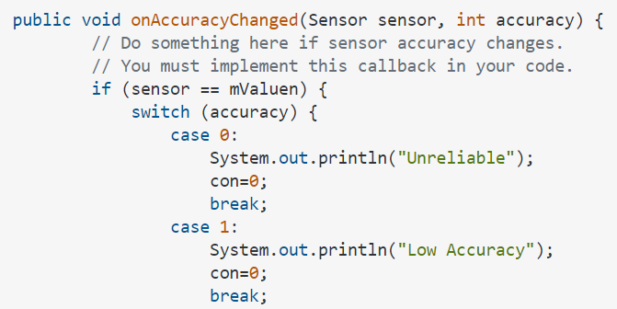
onSensorChanged / onAccuracyChanged
// Called when a registered sensor changes value
@Override
public void onSensorChanged(SensorEvent event){
EditText field = (EditText)findViewById(R.id.editText3);
field.setText(event.values[0] + " / " + event.values[1] + " / " + event.values[2]);
}
// Called when a registered sensor's accuracy changes
@Override
public void onAccuracyChanged(Sensor mSensor, int value) {
}

Slide 9
onResume / onPause
//The arguments passed into the registerListener method determine the sensor that you are connected to and the rate at which it will send you updates
@Override
protected void onResume() {
super.onResume();
mSensorManager.registerListener(this, mSensor, SensorManager.SENSOR_DELAY_NORMAL);
}
@Override
protected void onPause() {
super.onPause();
mSensorManager.unregisterListener(this);
}
}

Slide 10
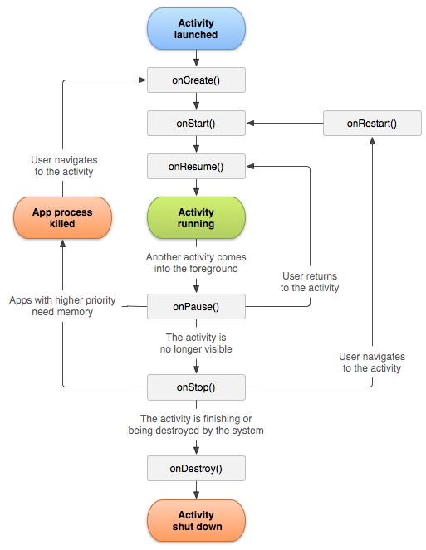

Slide 11
Layout
<RelativeLayout xmlns:android="http://schemas.android.com/apk/res/android"
xmlns:tools="http://schemas.android.com/tools"
android:layout_width="match_parent"
android:layout_height="match_parent" >
<EditText
android:layout_width="wrap_content"
android:layout_height="wrap_content"
android:inputType="textMultiLine"
android:id="@+id/editText3"
android:layout_below="@+id/textView"
android:layout_centerHorizontal="true"
android:layout_marginTop="10dp" />
<TextView
android:layout_width="wrap_content"
android:layout_height="wrap_content"
android:text="Linear Acceleration"
android:id="@+id/textView"
android:layout_centerHorizontal="true"
android:layout_marginBottom="10dp" />
</RelativeLayout>

Slide 12
Hint for multiple sensors
public class MyActivity … {
private class AccelListener implements SensorEventListener {
public void onSensorChanged(SensorEvent sensorEvent) {
…
}
public void onAccuracyChanged(Sensor arg0, int arg1) {}
}
private class LightListener implements SensorEventListener {
public void onSensorChanged(SensorEvent sensorEvent) {
…
}
public void onAccuracyChanged(Sensor arg0, int arg1) {}
}
private SensorEventListener accelListener_ = new AccelListener();
private SensorEventListener lightListener_ = new LightListener();
…
public void onResume(){
…
sensorManager_.registerListener(accelListener, accelerometer,
SensorManager.SENSOR_DELAY_GAME);
sensorManager_.registerListener(lightListener, lightsensor,
SensorManager.SENSOR_DELAY_NORMAL);
}
public void onPause(){
sensorManager_.unregisterListener(accelListener_);
sensorManager_.unregisterListener(lightListener_);
}

Slide 13
Lab 2b
Notes:
Review today, not so fast in future

Slide 14
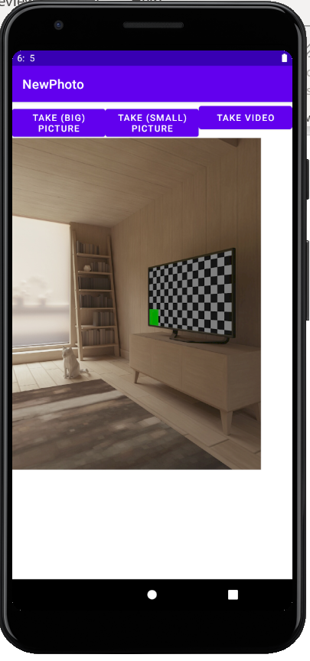
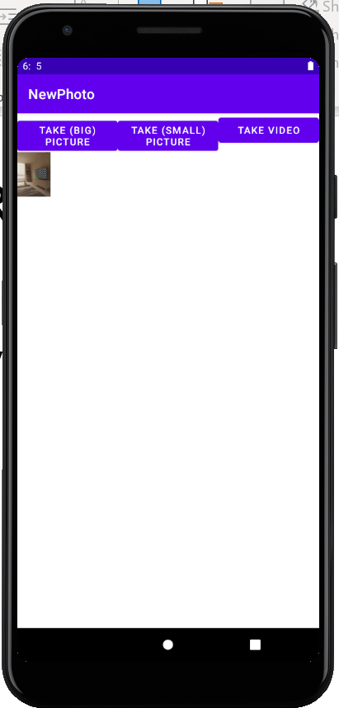
Requirement
Lab 2b: photo
I will show you:
Take big picture and save it
You will do:
Take small picture
(If have more time)
Take video
Demo

Slide 15
Manifest
Create a project called photo
put a <user-feature> tag to advertise that your application depends on having a camera
Enable the image capture action
put a <uses-permission> tag to enable write permission to the external storage
<?xml version="1.0" encoding="utf-8"?>
<manifest xmlns:android="http://schemas.android.com/apk/res/android"
package="com.example.photo">
<uses-feature android:name="android.hardware.camera"
android:required="true" />
<queries>
<intent>
<action android:name="android.media.action.IMAGE_CAPTURE" />
</intent>
</queries>
<uses-permission android:name="android.permission.WRITE_EXTERNAL_STORAGE"/>
<uses-permission android:name="android.permission.READ_EXTERNAL_STORAGE" />

Slide 16
Manifest
Configure the FileProvider: add a provider to your application
Make sure that the authorities string matches the argument to getUriForFile in the app
<application
…
<provider
android:name="androidx.core.content.FileProvider"
android:authorities="com.example.photo.provider"
android:exported="false"
android:grantUriPermissions="true">
<meta-data
android:name="android.support.FILE_PROVIDER_PATHS"
android:resource="@xml/provider_paths" />
</provider>
….
</application>

Slide 17
Create the resource file
The provider expects paths to be configured in res/xml/ provider_paths.xml
Create a xml directory under res, create a provider_paths.xml file
<?xml version="1.0" encoding="utf-8"?>
<paths>
<external-path name="external_files" path="."/>
</paths>

Slide 18
Layout / String
<?xml version="1.0" encoding="utf-8"?>
<LinearLayout xmlns:android="http://schemas.android.com/apk/res/android"
android:orientation="vertical"
android:layout_width="match_parent"
android:layout_height="match_parent"
>
<LinearLayout
android:orientation="horizontal"
android:layout_height="wrap_content"
android:layout_width="match_parent"
>
<Button android:text="@string/btnIntend" android:id="@+id/btnIntend"
android:layout_height="wrap_content"
android:layout_width="0dp"
android:layout_weight="1" />
<Button android:text="@string/btnIntendS" android:id="@+id/btnIntendS"
android:layout_height="wrap_content"
android:layout_width="0dp"
android:layout_weight="1" />
<Button android:text="@string/btnIntendV" android:id="@+id/btnIntendV"
android:layout_height="wrap_content"
android:layout_width="0dp"
android:layout_weight="1" />
</LinearLayout>
<ImageView
android:layout_height="wrap_content"
android:layout_width="wrap_content"
android:visibility="visible"
android:id="@+id/imageView1" />
<VideoView
android:layout_height="wrap_content"
android:layout_width="wrap_content"
android:visibility="invisible"
android:id="@+id/videoView1" />
</LinearLayout>
<resources>
<string name="app_name">Photo</string>
<string name="btnIntend">Take (big) Picture</string>
<string name="btnIntendS">Take (small) Picture</string>
<string name="btnIntendV">Take Video</string>
</resources>

Slide 19
Main Code
Notes:
Review today, not so fast in future

Slide 20
public class MainActivity extends AppCompatActivity {
private static final int ACTION_TAKE_PHOTO_B = 1;
private static final int ACTION_TAKE_PHOTO_S = 2;
private static final int ACTION_TAKE_VIDEO = 3;
private static final String BITMAP_STORAGE_KEY = "viewbitmap";
private static final String IMAGEVIEW_VISIBILITY_STORAGE_KEY = "imageviewvisibility";
private static final String VIDEO_STORAGE_KEY = "viewvideo";
private static final String VIDEOVIEW_VISIBILITY_STORAGE_KEY = "videoviewvisibility";
private String mCurrentPhotoPath;
private ImageView mImageView;
private Bitmap mImageBitmap;
private VideoView mVideoView;
private Uri mVideoUri;

Slide 21
/** Called when the activity is first created. */
@Override
public void onCreate(Bundle savedInstanceState) {
super.onCreate(savedInstanceState);
setContentView(R.layout.activity_main);
mImageView = (ImageView) findViewById(R.id.imageView1);
mVideoView = (VideoView) findViewById(R.id.videoView1);
mImageBitmap = null;
mVideoUri = null;
Button picBtn = (Button) findViewById(R.id.btnIntend);
picBtn.setOnClickListener(mTakePicOnClickListener);
}
Button.OnClickListener mTakePicOnClickListener =
new Button.OnClickListener() {
@Override
public void onClick(View v) {
dispatchTakePictureBIntent();
}
};

Slide 22
The Android way of delegating actions to other applications is to invoke an Intent that describes what you want done. Three components: the Intent itself, a call to start the external Activity, some code to handle the image data when focus returns to your activity.
private void dispatchTakePictureBIntent() {
Intent takePictureIntent = new Intent(MediaStore.ACTION_IMAGE_CAPTURE);
String timeStamp = new SimpleDateFormat("yyyyMMdd_HHmmss").format(new Date());
String imageFileName = "IMG_" + timeStamp + ".jpg";
File albumF = getAlbumDir();
File f = new File(albumF, imageFileName);
mCurrentPhotoPath = f.getAbsolutePath();
Uri contentUri = FileProvider.getUriForFile(
this,
"com.example.photo.provider",
f);
takePictureIntent.putExtra(MediaStore.EXTRA_OUTPUT, contentUri);
startActivityForResult(takePictureIntent, ACTION_TAKE_PHOTO_B);
}
private void dispatchTakePictureSIntent() { => only have the yellow part, do not have to save as file
private void dispatchTakeVideoIntent() {

Slide 23
private File getAlbumDir() {
File storageDir = null;
if (Environment.MEDIA_MOUNTED.equals(Environment.getExternalStorageState())) {
storageDir = new File(Environment.getExternalStoragePublicDirectory(Environment.DIRECTORY_PICTURES), “CameraSample”);
if (storageDir != null) {
if (! storageDir.mkdirs()) {
if (! storageDir.exists()){
Log.d("CameraSample", "failed to create directory");
return null;
}
}
}
} else {
Log.v(getString(R.string.app_name), "External storage is not mounted READ/WRITE.");
}
return storageDir;
}

Slide 24
The Android Camera application encodes the photo/video in the return Intent delivered to onActivityResult().
startActivityForResult(takePictureIntent, ACTION_TAKE_PHOTO_B);
@Override
protected void onActivityResult(int requestCode, int resultCode, Intent data) {
switch (requestCode) {
case ACTION_TAKE_PHOTO_B: {
if (resultCode == RESULT_OK) {
handleBigCameraPhoto();
}
break;
}
case ACTION_TAKE_PHOTO_S: {
case ACTION_TAKE_VIDEO: {
}
}

Slide 25
//retrieves the image from path and displays it in an ImageView.
private void handleBigCameraPhoto() {
if (mCurrentPhotoPath != null) {
Bitmap bitmap = BitmapFactory.decodeFile(mCurrentPhotoPath);
mImageView.setImageBitmap(bitmap);
mVideoUri = null;
mImageView.setVisibility(View.VISIBLE);
mVideoView.setVisibility(View.INVISIBLE);
mCurrentPhotoPath = null;
}
}
//The photo is encoded as a small Bitmap in the extras, under the key "data".
private void handleSmallCameraPhoto(Intent intent) {
Bundle extras = intent.getExtras();
mImageBitmap = (Bitmap) extras.get("data");
….
}
private void handleCameraVideo(Intent intent) {
mVideoUri = intent.getData();
….
mVideoView.start(); => do not forget to start playing it
}

Slide 26
//to handle some display issue
@Override
protected void onSaveInstanceState(Bundle outState) {
outState.putParcelable(BITMAP_STORAGE_KEY, mImageBitmap);
outState.putParcelable(VIDEO_STORAGE_KEY, mVideoUri);
outState.putBoolean(IMAGEVIEW_VISIBILITY_STORAGE_KEY, (mImageBitmap != null) );
outState.putBoolean(VIDEOVIEW_VISIBILITY_STORAGE_KEY, (mVideoUri != null) );
super.onSaveInstanceState(outState);
}
@Override
protected void onRestoreInstanceState(Bundle savedInstanceState) {
super.onRestoreInstanceState(savedInstanceState);
mImageBitmap = savedInstanceState.getParcelable(BITMAP_STORAGE_KEY);
mVideoUri = savedInstanceState.getParcelable(VIDEO_STORAGE_KEY);
mImageView.setImageBitmap(mImageBitmap);
mImageView.setVisibility(
savedInstanceState.getBoolean(IMAGEVIEW_VISIBILITY_STORAGE_KEY) ?
ImageView.VISIBLE : ImageView.INVISIBLE
);
mVideoView.setVideoURI(mVideoUri);
mVideoView.setVisibility(
savedInstanceState.getBoolean(VIDEOVIEW_VISIBILITY_STORAGE_KEY) ?
ImageView.VISIBLE : ImageView.INVISIBLE
);
}

Slide 27
Where is the gallery (of save big pic)?
On the emulator:
Files -> sdk_gphone -> picture -> CameraSample
On my phone:
Internal storage -> picture -> CameraSample
Run on your phone:
Settings -> Developer options -> Debugging -> USB debugging
If the app crashes -> App info -> Permissions -> Storage

